Slide 1
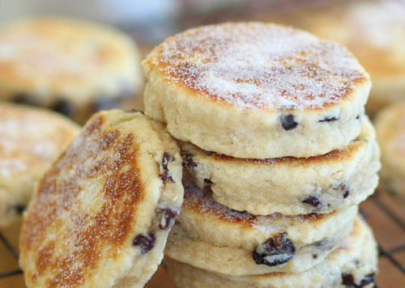
Saint David’s day

Slide 2
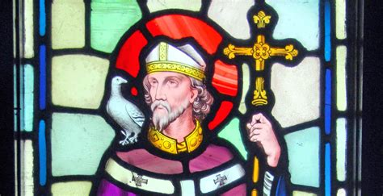
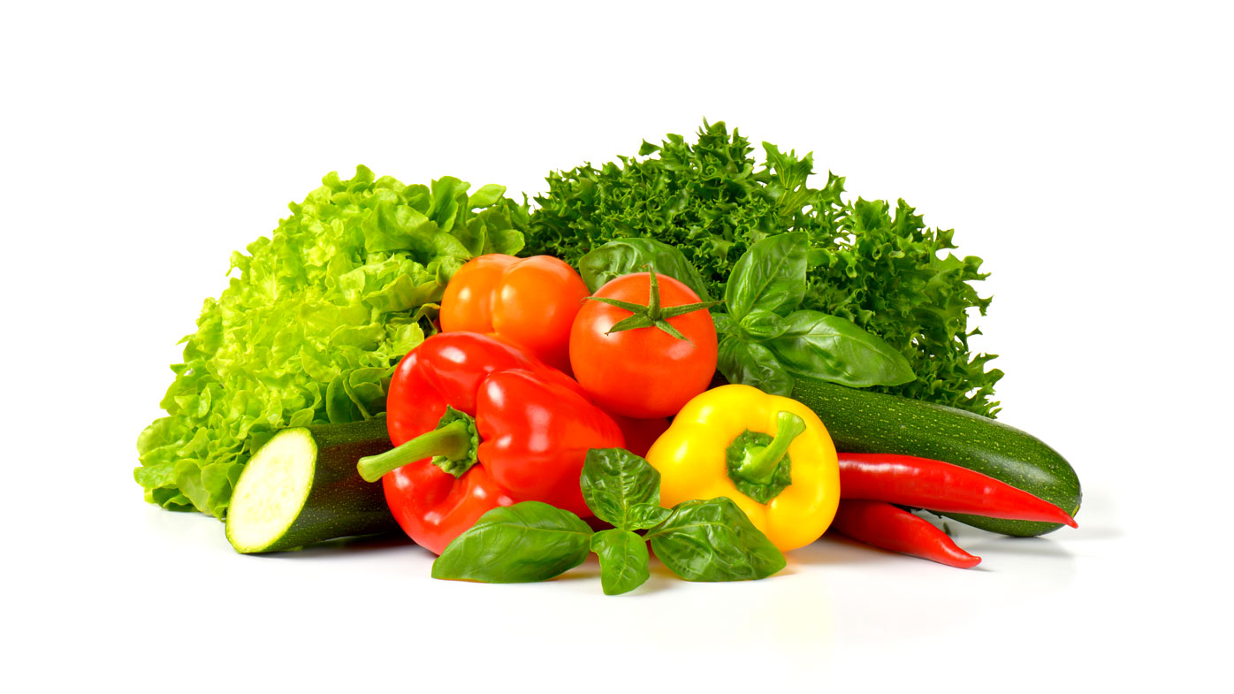

Slide 3
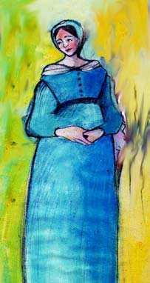
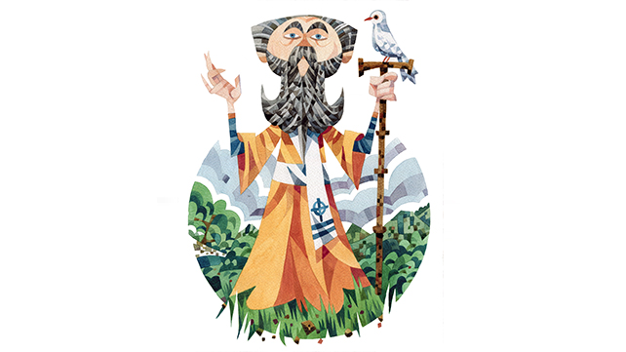

Slide 4
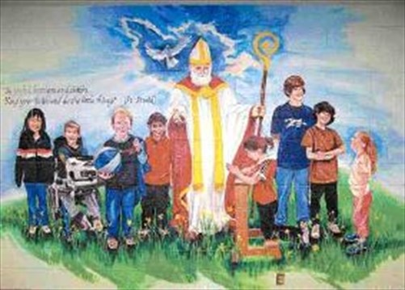

Slide 5
True or False Game
We’re going to pick six people to come and find a carrot in the soil. Read the text then tell us if it’s true or false from what you’ve heard from the story.

